Slide 1
Weekly report: Electrical Drivetrain
Week number: 6
Date: 04/11/2025
Supervisor: Prof. Dr.-Ing. Saiju
Group members: Aiswarya Vijayan, Vishranti Shivajirao Patil , Girish Mahadeo Padalkar, Cristina Milene Vergara Hernandez

Slide 2
List of contents
  Converter Size and Configuration
  IGBT Module Structure
  IGBT Configuration
  How IGBT is connected
  Control Structure Overview
  Control structure of Converter
  Component Dimensions & Parameters
  Next steps
Aiswarya Vijayan
Electrical Drive Train/ Optimus Syria

Slide 3
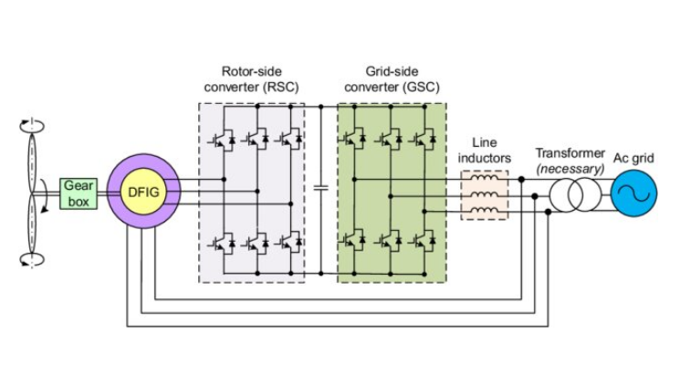
1.Converter Size and Configuration
Type: 2-Level Back-to-Back Voltage Source Converter (VSC)
• Power rating: ~25% - 30% of 5 MW → ≈1.25 - 1.5 MW
• DC-link voltage ≈ 1.2 kV
• Converter cabinet: ~1.8×1.0×2.0 m, ~2 tons each side
• Components: Rotor-Side Converter (RSC), Grid-Side Converter (GSC), DC-link capacitors
Source: https://www.researchgate.net/publication/263364715_Electrical_machines_and_power-electronic_systems_for_high-power_wind_energy_generation_applications_Part_II_-_Power_electronics_and_control_systems
Electrical Drive Train/ Optimus Syria

Slide 4
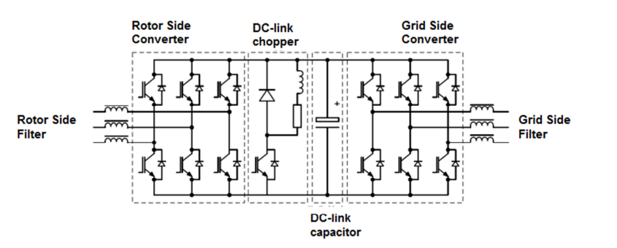
2. IGBT Module Structure
Each converter leg uses 2 IGBTs per phase, often paralleled for current rating
• Gate-driver boards mounted close to IGBTs to minimize inductance
• Liquid cooling manifold distributes coolant through all modules
• Compact cabinet includes filter inductors, DC-link capacitors, and control boards
Aiswarya Vijayan
Electrical Drive Train/ Optimus Syria

Slide 5
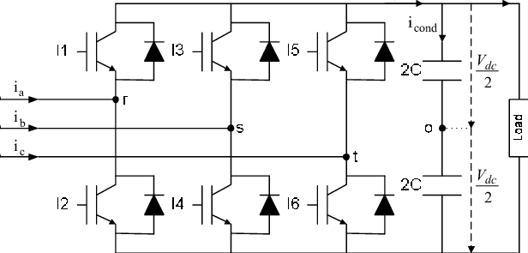
3. IGBT Configuration
Converter Device Configuration
2-level, 3-phase bridge per converter (RSC & GSC)
Each phase leg = 2 IGBTs (upper & lower) + anti-parallel diodes
3 legs × 2 IGBTs = 6 IGBTs per converter
RSC + GSC → 12 IGBTs total
Parallel Module Sizing
Converter power = 1.25 MW, V = 690 V LL
Phase current ≈ P / (√3 × V) = 1 046 A RMS
Module rating = 1 200 A @ 1 700 V → derated to
0.85 × 1 200 = 1 020 A
Required parallels = 2 modules per leg
6 half-bridge modules per converter (3 legs × 2 parallel)
12 modules total for back-to-back converter
https://www.researchgate.net/publication/224697059_Optimized_Direct_Power_Control_Strategy_using_Output_Regulation_Subspaces_and_Pulse_Width_Modulation
Aiswarya Vijayan
Electrical Drive Train/ Optimus Syria

Slide 6
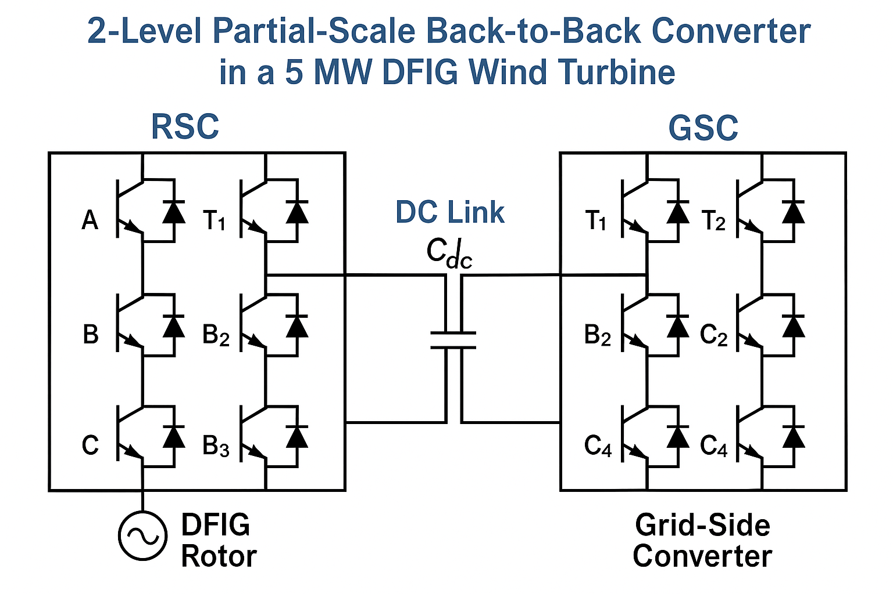
3. How IGBT is connected
Each converter (RSC or GSC) has:
Three phase legs (A, B, C)
Each leg: Two IGBTs connected in series is connected through a DC-link capacitor.
RSC controls rotor current (torque + reactive power).
GSC controls DC-link & grid reactive power.
Aiswarya Vijayan
Electrical Drive Train/ Optimus Syria

Slide 7
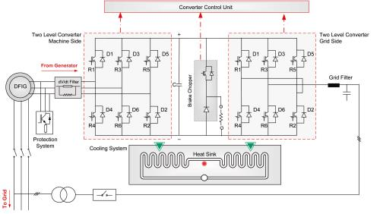
4. Control Structure Overview
DFIG uses two converters:
1. Rotor-Side Converter (RSC) – controls torque and reactive power
2. Grid-Side Converter (GSC) – maintains DC-link voltage and power factor
• Control performed in dq synchronous reference frame using vector control
• Communication between RSC and GSC through DC-link voltage feedback
Source : https://www.ingeteam.com/us/en-us/power-electronics/wind-power-energy
Aiswarya Vijayan
Electrical Drive Train/ Optimus Syria

Slide 8
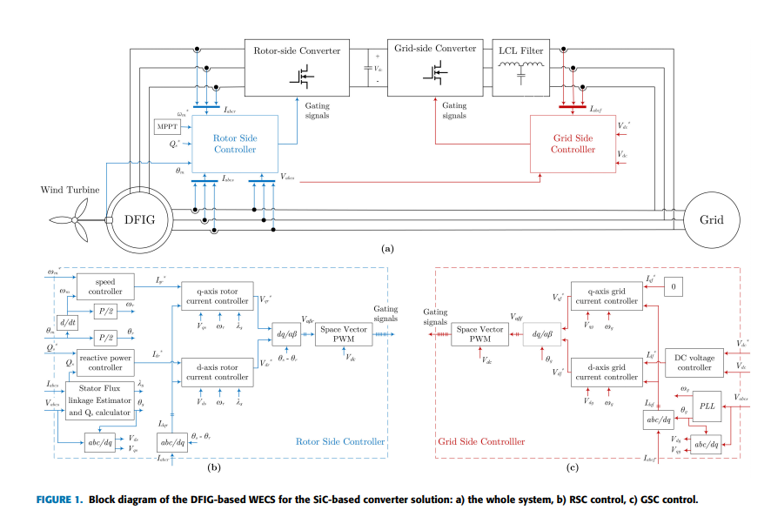
5. Control structure of Converter
Electrical Drive Train/ Optimus Syria

Slide 9
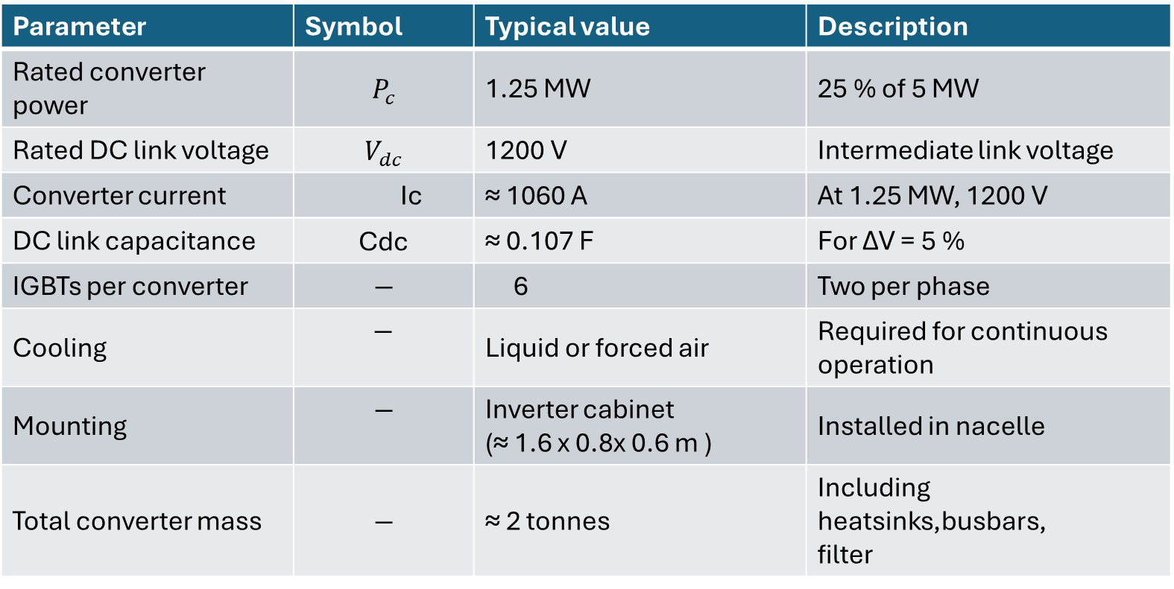
6. Component Dimensions & Parameters
Parameter | Symbol | Typical value | Description
Rated converter power | $$P_{c}$$ | 1.25 MW | 25 % of 5 MW
Rated DC link voltage | $$V_{dc}$$ | 1200 V | Intermediate link voltage
Converter current | Ic​ | ≈ 1060 A | At 1.25 MW, 1200 V
DC link capacitance | $$\text{Cdc}\text{​}$$ | ≈ 0.107 F | For ΔV = 5 %
IGBTs per converter | $$−$$ | 6 | Two per phase
Cooling | $−$ | Liquid or forced air | Required for continuous operation
Mounting | $$−$$ | Inverter cabinet (≈ 1.6 x 0.8x 0.6 m ) | Installed in nacelle
Total converter mass | $$−$$ | ≈ 2 tonnes | Including heatsinks,busbars, filter
Aiswarya Vijayan
Electrical Drive Train/ Optimus Syria

Slide 10
7.Next Step
Finalize all the Electrical parameters.
Finalize the size of each components.
Develop the complete DFIG drivetrain model in MATLAB/Simulink.
Aiswarya Vijayan

Slide 11

Bibliography
Z. Q. Zhu and J. Hu, “Electrical machines and power-electronic systems for high-power wind energy generation applications: Part II – power electronics and control systems,” COMPEL: The International Journal for Computation and Mathematics in Electrical and Electronic Engineering, vol. 32, no. 1, pp. 34-71, 2013, doi: 10.1108/03321641311293740.(accessed on 31/10/2025)
Hussain, H. A., Loncarski, J., Ristic, L. B., & Bellini, A., “DFIG-Based WECS With Partial-Scale Converter: Efficiency, Cost, and Volume Comparison of SiC-Based and IGBT-Based Converter Solution,” IEEE Access, vol. 12, pp. 89908-89920, 2024, doi: 10.1109/ACCESS.2024.3419810.(accessed on 30/10/2025)
Shabani, H. R., Hajizadeh, A., Kalantar, M., et al., “Transient stability analysis of DFIG-based wind farm-integrated power system considering gearbox ratio and reactive power control,” Electrical Engineering, vol. 105, pp. 3719-3735, Dec. 2023, doi: 10.1007/s00202-023-01906-3.(accessed on 01/11/2025)
El Moudden, A., Aarib, A., & Hmidat, A., “The Converter Command for the Doubly-Fed Induction Generator with Variable Speed used in the Wind Power Production,” International Journal of Applied Information Systems, vol. 8, no. 6, pp. 32-39, Apr. 2015, doi: 10.5120/ijais15-451335.(accessed on 31/10/2025)
F. Shafiei, “Modelling and Verification of Doubly Fed Induction Generator (DFIG) using Real Time Digital Simulator (RTDS),” Master’s thesis, Chalmers University of Technology, Göteborg, Sweden, 2012. [Online]. Available: https://publications.lib.chalmers.se/records/fulltext/169777/169777.pdf (accessed on 02/11/2025)
ABB, “ACS880-17 Cabinet-Built Single Drives Technical Catalog,” ABB Oy, Helsinki, Finland, 2023. [Online]. Available: https://new.abb.com/drives (accessed on 01/11/2025)
Semikron Danfoss, “SKiiP Intelligent Power Modules – Product Family Overview,” Nuremberg, Germany, 2023. [Online]. Available: https://www.semikron-danfoss.com (accessed on 01/11/2025)
TDK Electronics, “B25667 Series: Power Capacitors for DC-Link Circuits (MKP Technology),” Datasheet, 2024. [Online]. Available: https://product.tdk.com/en/catalog (accessed on 02/11/2025)
11/04/2025
Aiswarya Vijayan
9

